Slide 1
Group 10
Sprint3

Slide 2
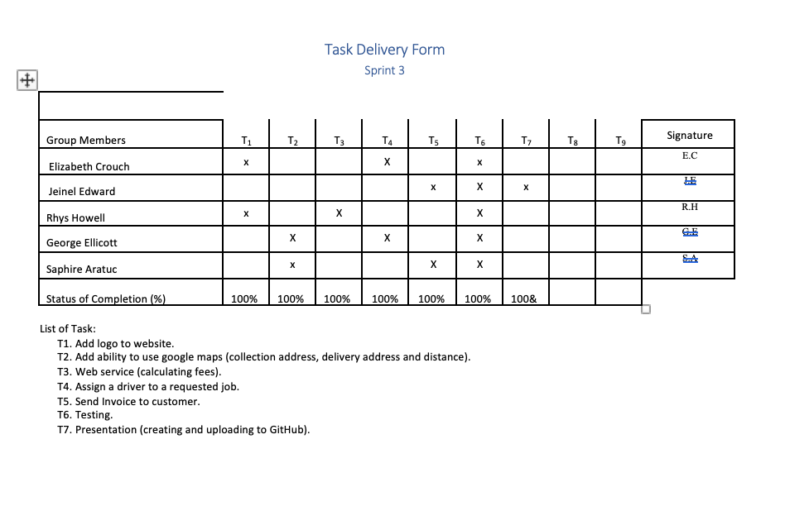
Roles and task Allocation

Slide 3
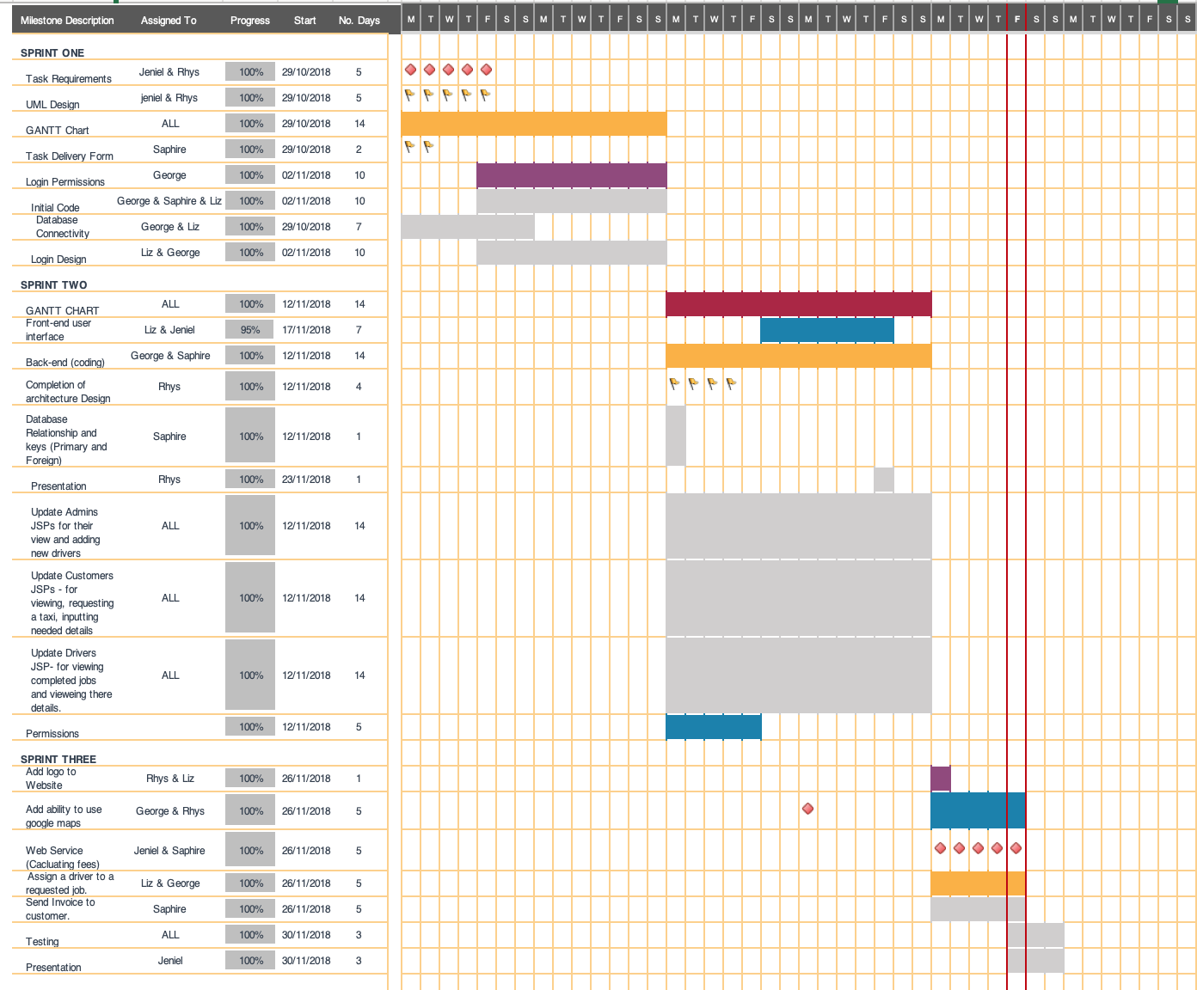
Gant Chart

Slide 4
Scrum 1
Identify tasks for sprint 3.
Allocate tasks to group members.
Added logo to website.

Slide 5
Scrum 2
Started the installations of the Google map service.
Updated the documentations
Fixed the delete user function from the admin site

Slide 6
Scrum 3

